Slide 1

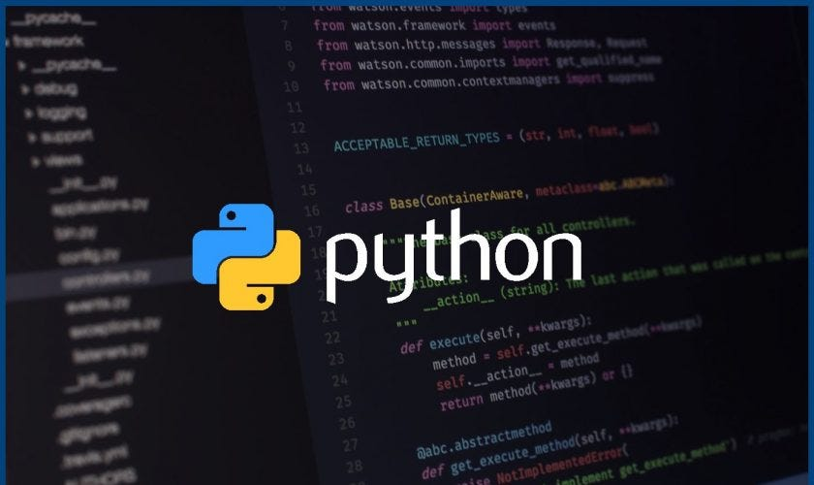
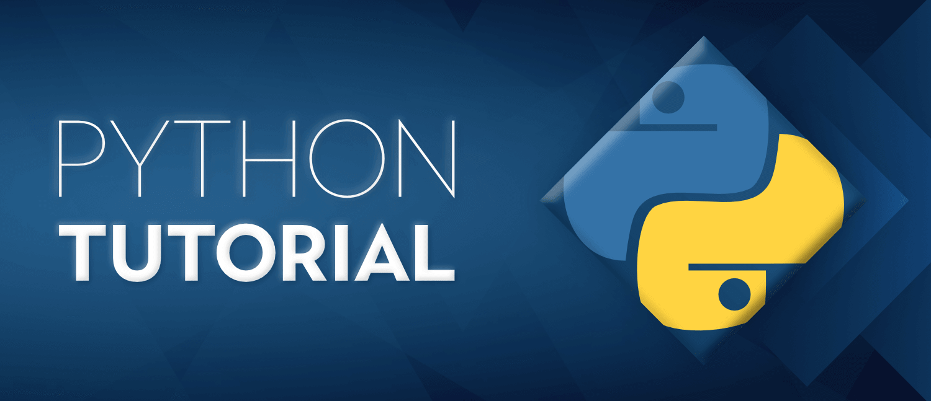
Python Bootcamp For Beginners

Slide 2

Introduction
Lesson 1
Introductions
Introduction to the Course
Setup Coding environment
Introduction to GitHub
Introduction to Coding
Introduction to Python
Python Syntax
Python Data/Variable Types

Slide 3
Introduction to the Course
Lesson 1
Topics
Python Syntax
Python Data Types
Python Conditions and If statements
Python Loops
Python Functions
Python Lambda
Python Arrays
Python Classes/Objects
Python Inheritance
Python Iterators
Python Scope
Python Modules
Python Math
Python JSON
Python Iterators
Python Try Except
Python User Input
Python String Formatting
Python Development Environments
File Handling
Python MySQL
Introduction to API's
Git Version control
Introduction to JupyterLab
Intro to Data Visualization

Slide 4
Introduction to the Course
Lesson 1
Expectations
Familiarity with the basics of Python programming
Ability to write Python programs
Confidence in working with Python libraries
Exposure to real-world applications of Python
Preparation for more advanced learning

Slide 5
Setup Coding environment
Lesson 1
What is an Integrated Development Environment (IDE)?
An Integrated Development Environment (IDE) is a software application that provides comprehensive tools for software development. Here are some examples of IDEs
Visual Studio:
It is a popular IDE developed by Microsoft that supports a variety of programming languages, including C#, C++, Python, and others.
Eclipse:
It is a widely used IDE for Java development, but it also supports other programming languages such as C++, Python, and PHP.
IntelliJ IDEA:
It is an IDE developed by JetBrains that supports multiple programming languages, including Java, Kotlin, and Scala.
NetBeans:
It is an open-source IDE that supports multiple programming languages, including Java, PHP, and C++.

Slide 6
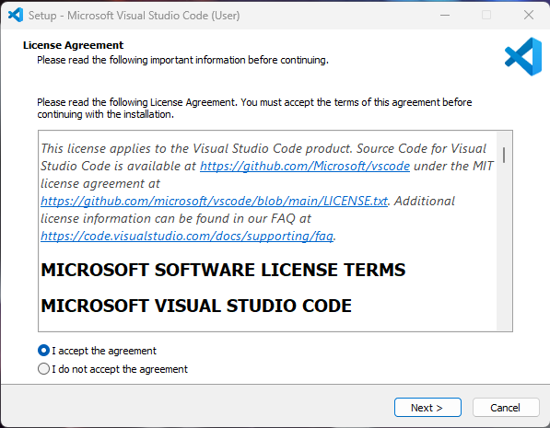
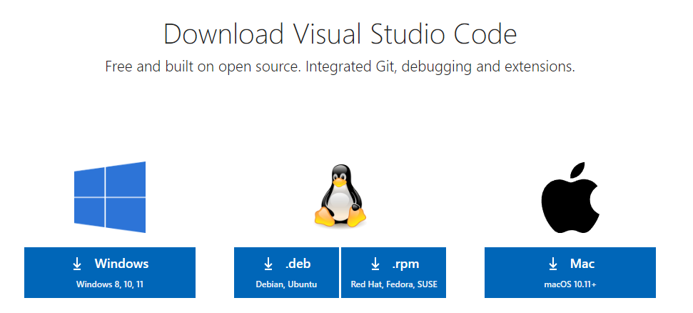
Setup Coding environment
Lesson 1
Installation of VS Code
Visual Studio Code, commonly known as VS Code, is a free and open-source code editor developed by Microsoft. It is available on Windows, macOS, and Linux operating systems.
Step 1 : Go to -
https://code.visualstudio.com/download
Step 2 :
Download the Visual Studio Code installer for Windows. Once it is downloaded, run the installer. Then, run the file – it will only take a minute.
Step 3 :
Accept the agreement and click “next.”

Slide 7
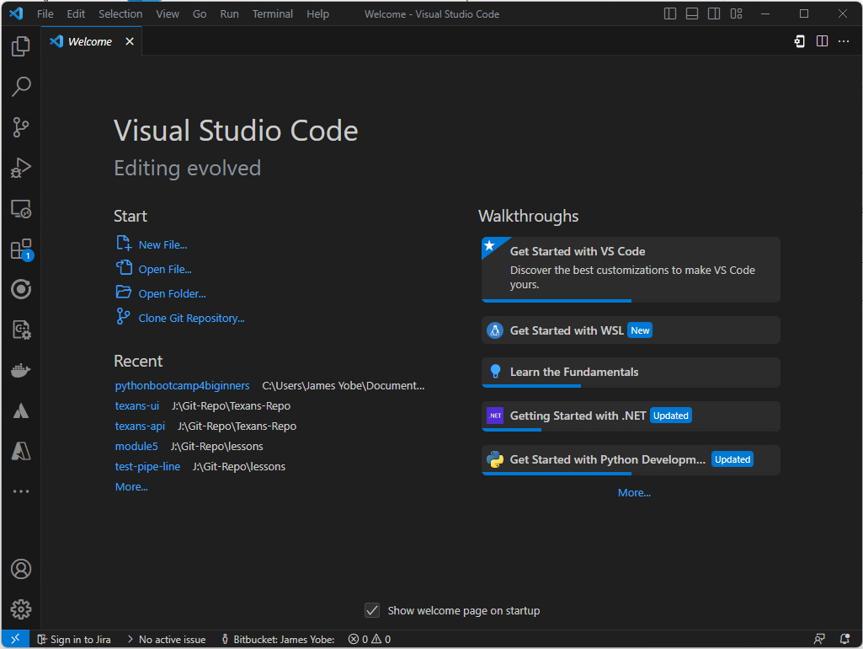
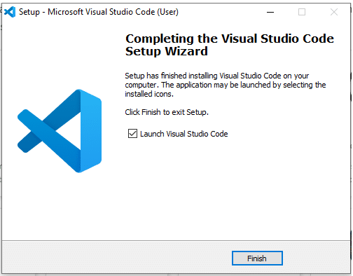
Setup Coding environment
Lesson 1
Step 4 :
After accepting all the requests press finish button. By default, VS Code installs under: "C:\users{username}\AppData\Local\Programs\Microsoft VS Code."
Step 5 :
Congratulation!! You have successfully installed VSCode

Slide 8
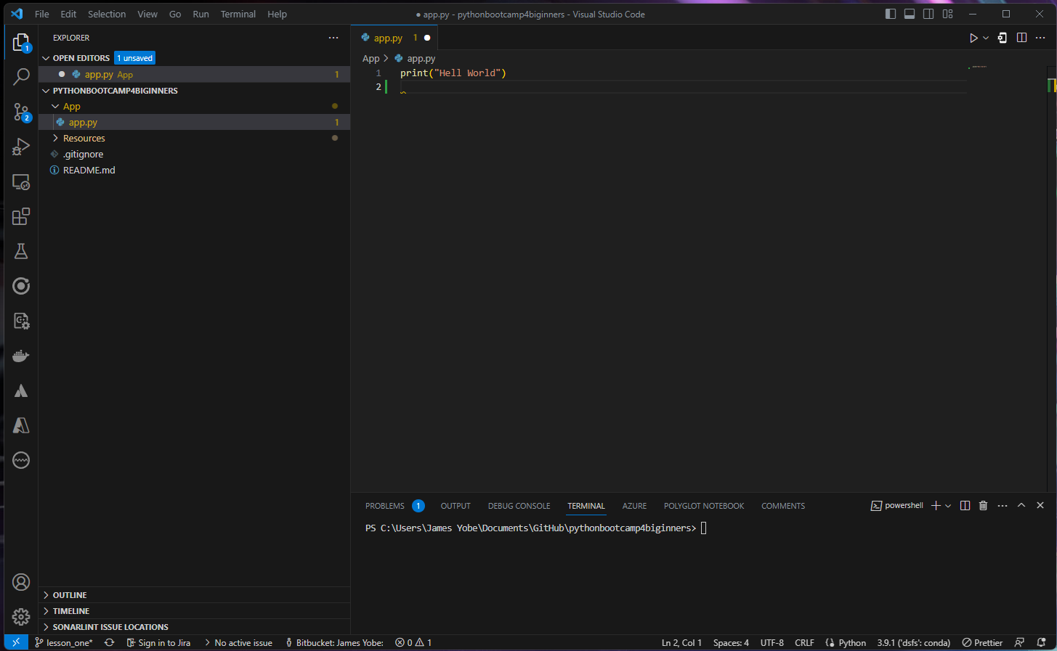
Setup Coding environment
Lesson 1
VS Code Interface
Menu
File Explorer
Run Button
Search
Source Control
Coding Environment
Folder
Files
Account
Terminal

Slide 9
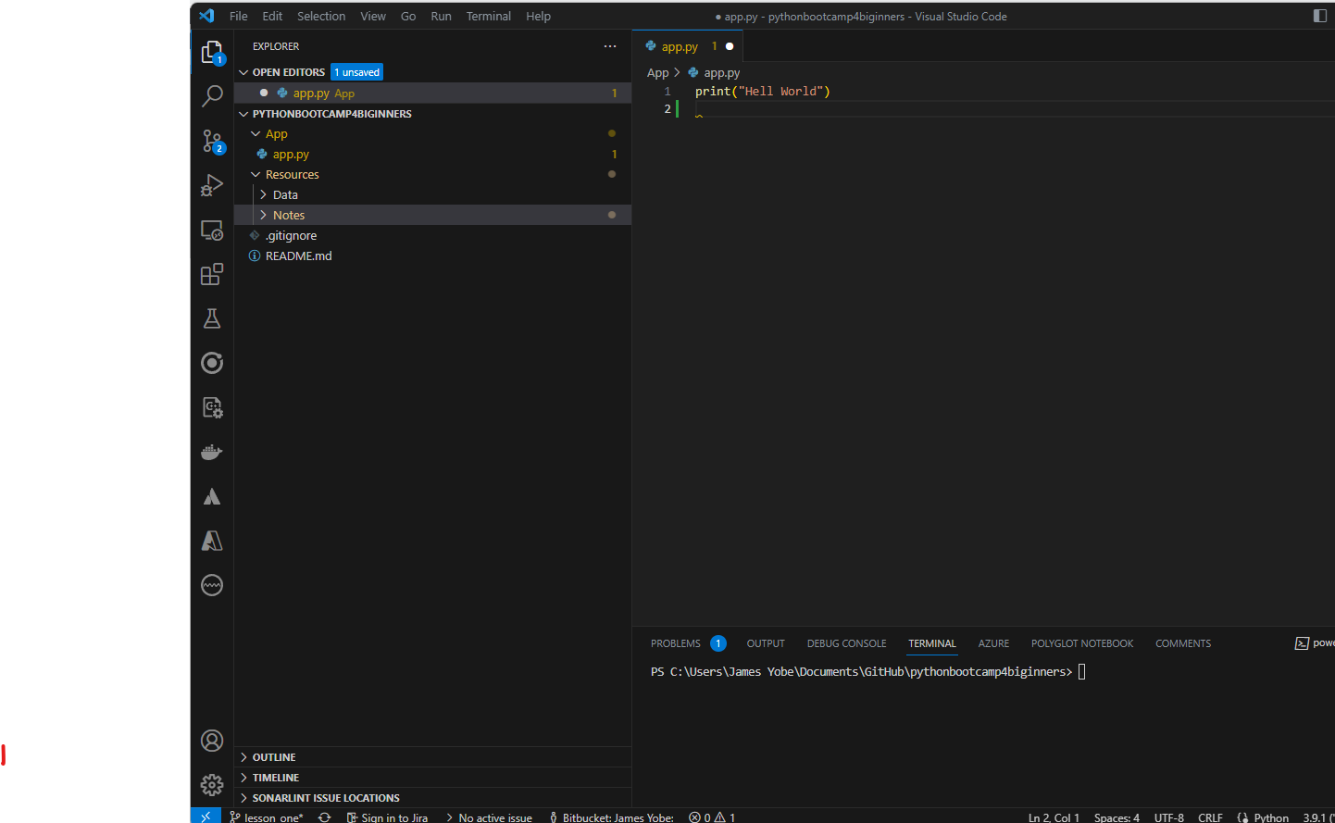
Setup Coding environment
Lesson 1
Bootcamp File structue
Folder
Python Code
Resources
Data Files
Class Notes
Lesson(Branch)

Slide 10
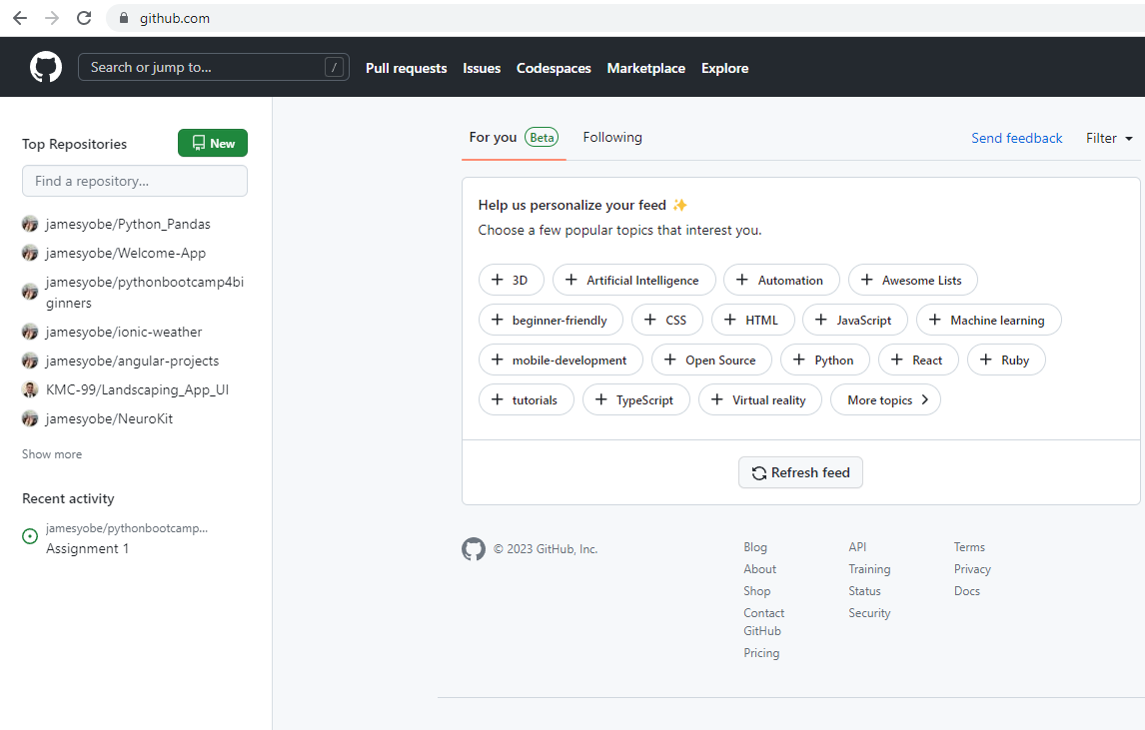
Introduction to GitHub
Lesson 1
What is GitHub
GitHub is a web-based platform that serves as a hub for software development collaboration. It is a Git repository hosting service, which means that it provides a place for developers to store and manage their code, track changes to that code over time, and collaborate with others on those changes.
GitHub offers a range of features, including version control, issue tracking, project management tools, and social networking features. It allows developers to work on projects in a distributed fashion, as multiple people can access and work on the same codebase simultaneously

Slide 11

Introduction to GitHub
Lesson 1
Setup GitHub Account
Step 1 : Go to
https://github.com/
Step 2 : Click Sign up

Slide 12
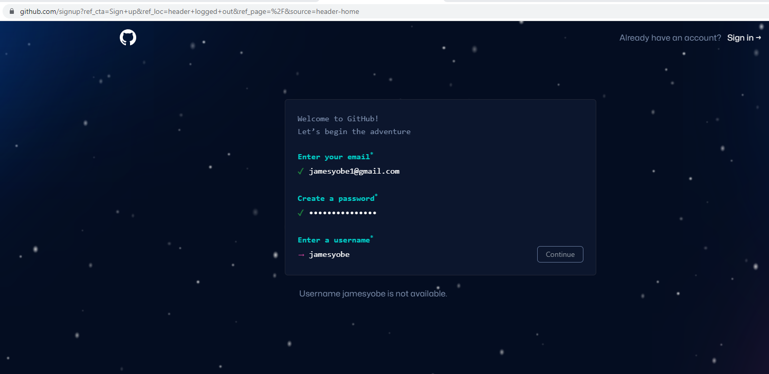
Introduction to GitHub
Lesson 1
Setup GitHub Account
Step 3 : Enter email
Step 4 : Enter Password
Step 5 : Enter Username

Slide 13
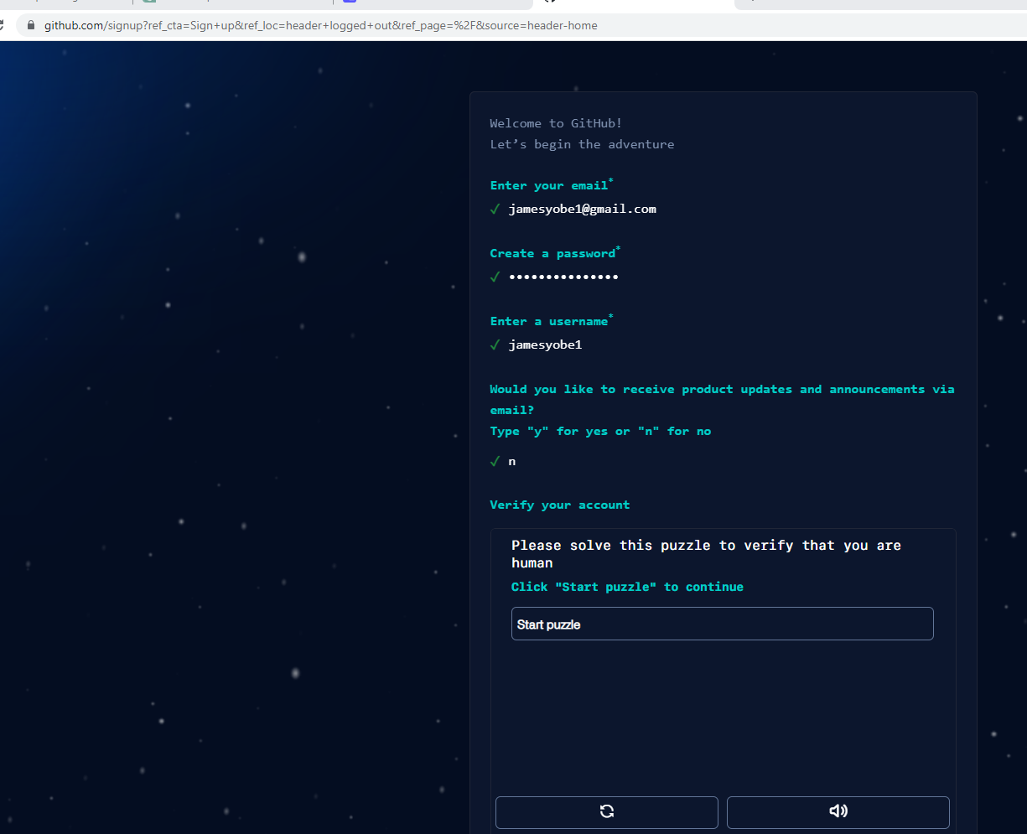
Introduction to GitHub
Lesson 1
Setup GitHub Account
Step 6 : receive updates
y/n
Step 7 : Verify Account
Click Start Puzzle

Slide 14
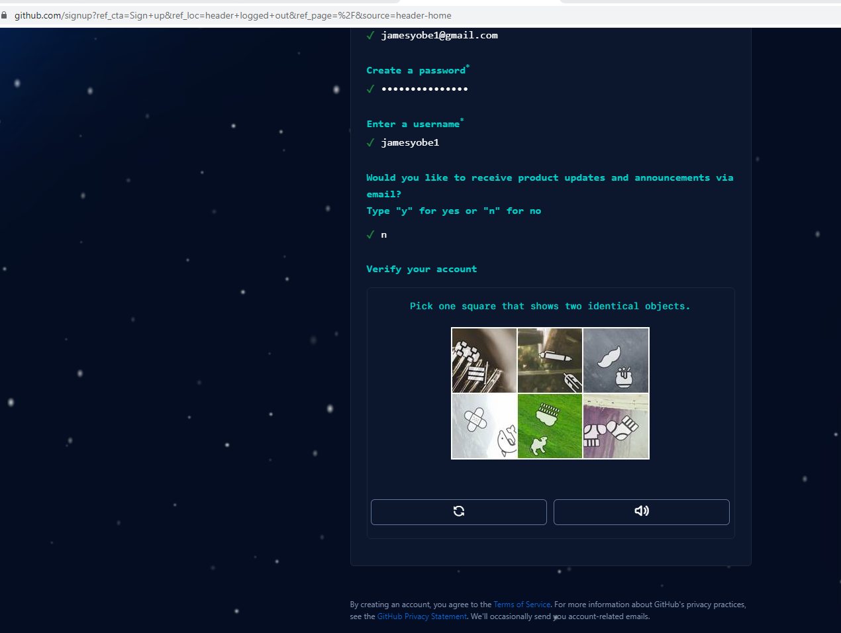
Introduction to GitHub
Lesson 1
Setup GitHub Account
Step 8 : Solve puzzle
Step 9 : Click Create Account after solving puzzles

Slide 15
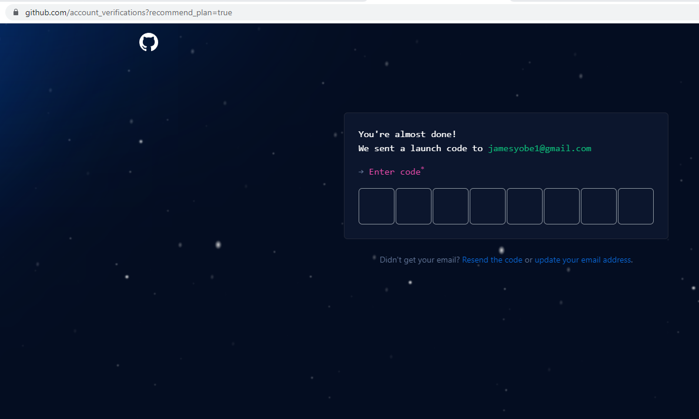
Introduction to GitHub
Lesson 1
Setup GitHub Account
Step 10 : Enter code sent to your email

Slide 16
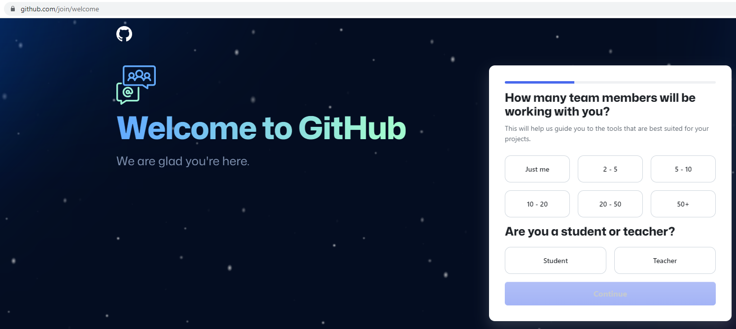
Introduction to GitHub
Lesson 1
Setup GitHub Account
Step 11 : Select Just Me
Step 12 : On next window click continue
Don’t select any options

Slide 17

Introduction to GitHub
Lesson 1
Setup GitHub Account
Step 13: Continue for free

Slide 18
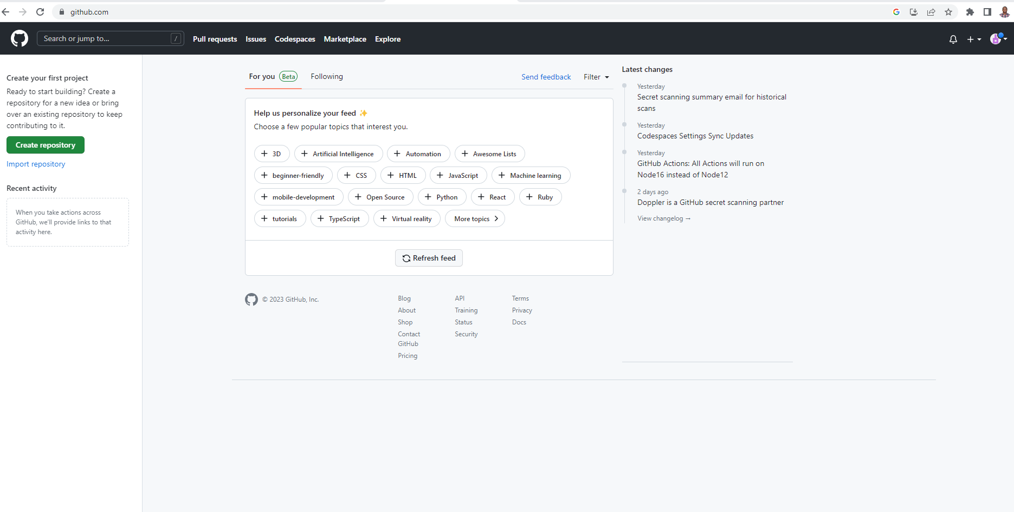
Introduction to GitHub
Lesson 1
Setup GitHub Account
Step 14: Congratulations!! You have successfully setup a GitHub Account

Slide 19
Introduction to Coding
Lesson 1
What is Coding?
Coding, also known as programming, is a process of creating step by step instruction for a computer to perform a task
Example – Instruction for a computer to find average of number
Coding involves writing a series of commands or algorithms using a programming language that a computer can interpret and act upon.

Slide 20
Introduction to Coding
Lesson 1
What is algorithms?
An algorithm is a set of instructions or steps that are followed to solve a problem or accomplish a specific task.
Algorithms can be found in many different fields, from mathematics and science to computer programming and engineering.
They are used to solve problems and automate tasks, and they can range from very simple to extremely complex.
The process of creating an algorithm typically involves breaking down a problem or task into smaller, more manageable steps.
Each step is then defined in a clear and concise manner, often using mathematical or logical expressions, to ensure that it can be easily understood and executed.

Slide 21
Introduction to Coding
Lesson 1
Data
Data refers to raw, unprocessed facts and figures that are collected or observed.
Data can be in various forms, such as numbers, text, images, audio, or video.
For example, a set of numbers, such as 1, 2, 3, 4, 5, is data.
Information:
Information is the processed, organized, and meaningful data that is derived from analyzing, interpreting, and summarizing the raw data.
Information provides context and meaning to the data, making it useful for decision-making.
For example, if we calculate the average of the above set of numbers, which is 3, it provides information that can be used to make decisions.
Input – Data entered into a computer for processing.
Output – Processed information given out of by computer.

Slide 22
Introduction to Python
Lesson 1
Python is a popular programming language.
Python is known for its simplicity and readability.

Slide 23
Introduction to Python
Lesson 1
Uses Of Python Programming
Web Development
Python has several frameworks like Django, Flask, and Pyramid that make it an excellent choice for developing web applications. Python's ease of use, simplicity, and scalability make it a popular choice for creating web applications.
Data Science and Machine Learning
Python's data handling and machine learning libraries like NumPy, Pandas, Scikit-learn, and TensorFlow make it an ideal language for data science and machine learning. Python's powerful libraries allow for the efficient processing of large amounts of data and support complex machine learning algorithms.
Scripting
Python is an excellent scripting language. It is easy to read and write, and its syntax is straightforward. Python's scripting capabilities make it an ideal language for automating repetitive tasks, system administration, and testing.
Scientific Computing
Python's scientific computing libraries, including SciPy, Matplotlib, and IPython, make it a popular choice for scientific computing. These libraries allow for efficient numerical computation, data visualization, and scientific research.

Slide 24
Introduction to Python
Lesson 1
Uses Of Python Programming
Web Development
Python has several frameworks like Django, Flask, and Pyramid that make it an excellent choice for developing web applications. Python's ease of use, simplicity, and scalability make it a popular choice for creating web applications.
Data Science and Machine Learning
Python's data handling and machine learning libraries like NumPy, Pandas, Scikit-learn, and TensorFlow make it an ideal language for data science and machine learning. Python's powerful libraries allow for the efficient processing of large amounts of data and support complex machine learning algorithms.
Scripting
Python is an excellent scripting language. It is easy to read and write, and its syntax is straightforward. Python's scripting capabilities make it an ideal language for automating repetitive tasks, system administration, and testing.
Scientific Computing
Python's scientific computing libraries, including SciPy, Matplotlib, and IPython, make it a popular choice for scientific computing. These libraries allow for efficient numerical computation, data visualization, and scientific research.
Other uses - Game Development, Desktop Application Development etc…

Slide 25
Python Syntax
Lesson 1
What is Syntax?
Syntax is ‘grammar’ that governs a programing language
Syntax refers to the rules that dictate how code should be written to be considered valid by the programming language.
Syntax specifies the structure, format, and order of the elements that make up a program, such as keywords, variables, operators, and punctuation.
Syntax is important because it determines whether or not the code will run properly.

Slide 26
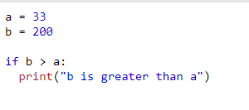
Python Syntax Continued
Lesson 1
To avoid syntax errors, programmers must follow the programming language’s rules closely and ensure their code is properly structured and formatted.
Python uses indentation to denote blocks of code, rather than using curly braces like other programming languages.

Slide 27
Python Data/Variable Types
Lesson 1
Integer
An integer is a whole number without a decimal point. For example, x = 5 assigns the value 5 to the variable x.
Float
A float is a number with a decimal point. For example, y = 3.14 assigns the value 3.14 to the variable y.
String
A string is a sequence of characters enclosed in single or double quotes. For example, name = "John" assigns the string "John" to the variable name.
Boolean
A boolean is a binary value that can either be True or False. For example, is_raining = True assigns the value True to the variable is_raining.

Slide 28
Python Data Types Continued
Lesson 1
List
A list is a collection of items that are ordered and changeable. For example, fruits = ["apple", "banana", "cherry"] assigns a list of fruits to the variable fruits.
Tuple
A tuple is a collection of items that are ordered and unchangeable. For example, coordinates = (10, 20) assigns a tuple of coordinates to the variable coordinates.
Dictionary
A dictionary is a collection of key-value pairs. For example, person = {"name": "John", "age": 30} assigns a dictionary of a person's information to the variable person.

Slide 29
Practice & Question
Lesson 1
Hello World
Print Your name
Add 2 Numbers
Print “Python is awesome”
Print “Python is awesome” where each word is stored in a different variable
Find Average of numbers

